Slide 1

WHALING PHISHING ATTACK
(CNS PROJECT)
Priyanshu Singh
2016UCP1393
Gaurav Kabra
2016UCP1471
Mukul Kumar
2016UCP1116

Slide 2
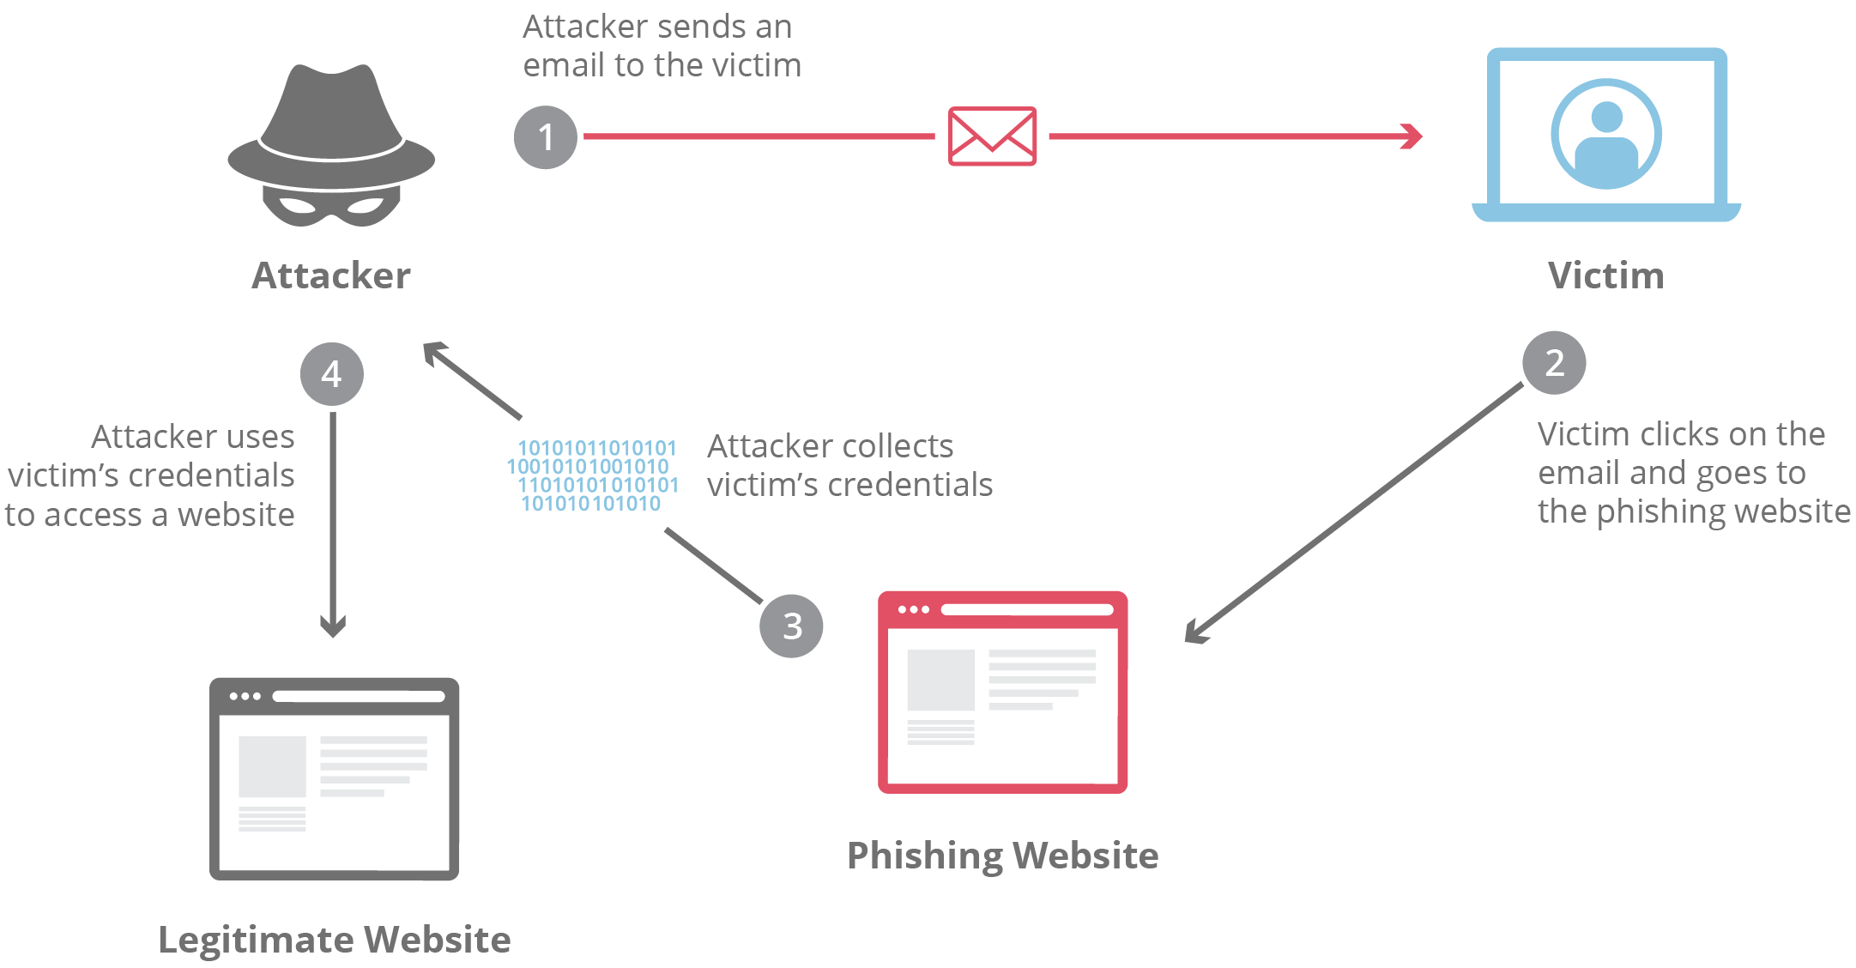
PHISHING(Fraudulent attempt to obtain sensitive information)

Slide 3
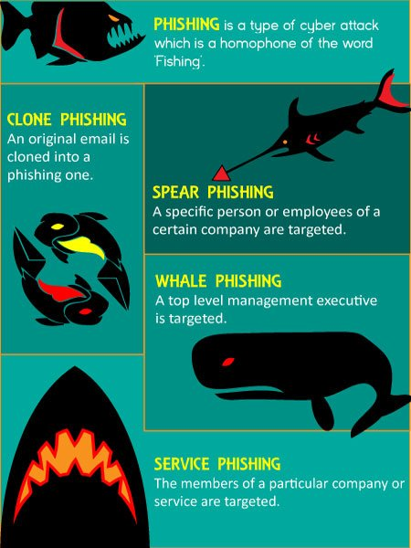
INTRODUCTION→WHALING
WHALING : Target Senior Management of company
Whaling → Size of the attacks
Victims : High Profile Employees e.g. CEO,CTO,CFO

Slide 4
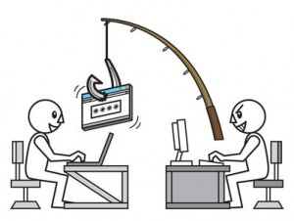
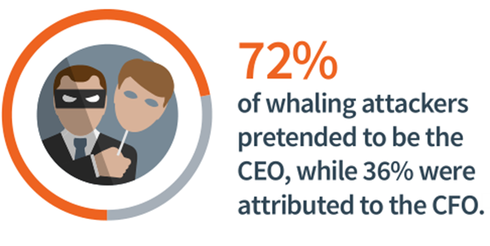
CHARACTERSTICS
Targets are bigger
Focus on specific high level executive
Leverage authority of CEO,CFO,CTO
Attacker in disguise of Senior
Goal: Gain access to sensitive data or money
Demands more research and planning
Cybercriminal browse social media & public profiles to plan for attack
Social engineering, email & content spoofing

Slide 5

REAL WORLD EXAMPLES
October 2017, Finance executive of Mattel,Inc sent $3 million ring of criminals.
June, 2015, Ubiquiti Networks Inc. transferred $46.7 million to several fake vendors (recovered $8.1 million)
June 2014, Keith McMurtry
Scoular’s corporate controller received a fake email pretending to be from the company’s CEO (Total loss : $17.2 million)

Slide 6
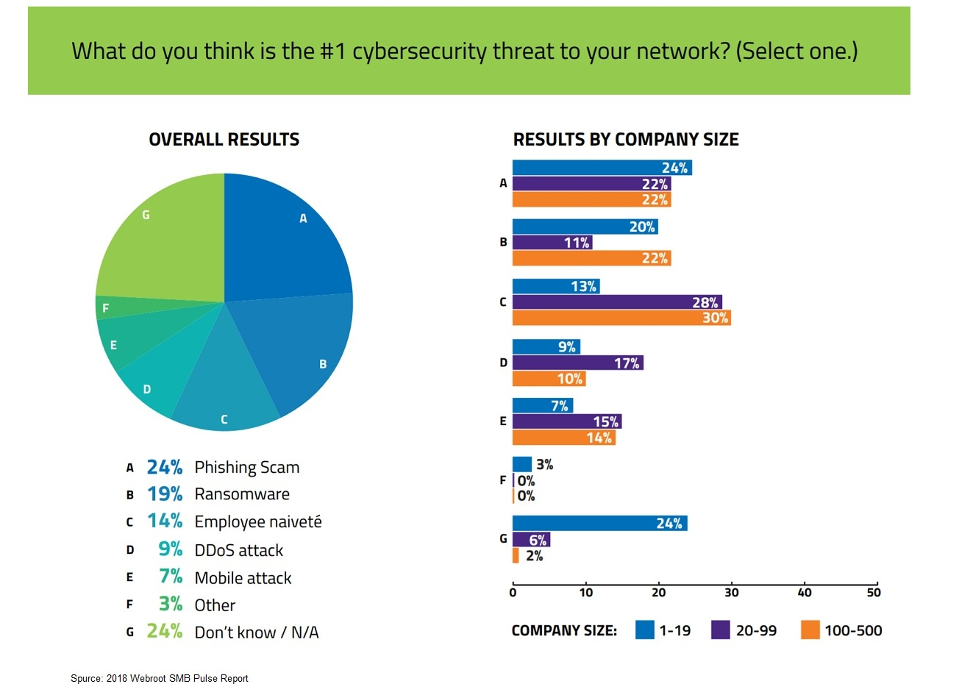
HOW BIG THE PROBLEM IS ?
US Survey : 270% rise in whaling cases from January to August 2015
FBI report→business losses > $1.2 billion in 2 years
In the U.S., UK and Europe
Since 2013, more than $12 billion has been unwittingly sent by 78,617
More than 50,000 CFOs trageted in 2017

Slide 7
PREVENTION AGAINST WHALING
Protection against unknown or newly registered domains
Make email security training mandatory for key individuals
Implement Multi-Layer Security Systems
Some more preventive measures...
Establish Secure Fund-Transfer Procedures
Incorporate an Anti-Spymail Solution
Exercise Flexibility with Your Cybersecurity Policy

Slide 8
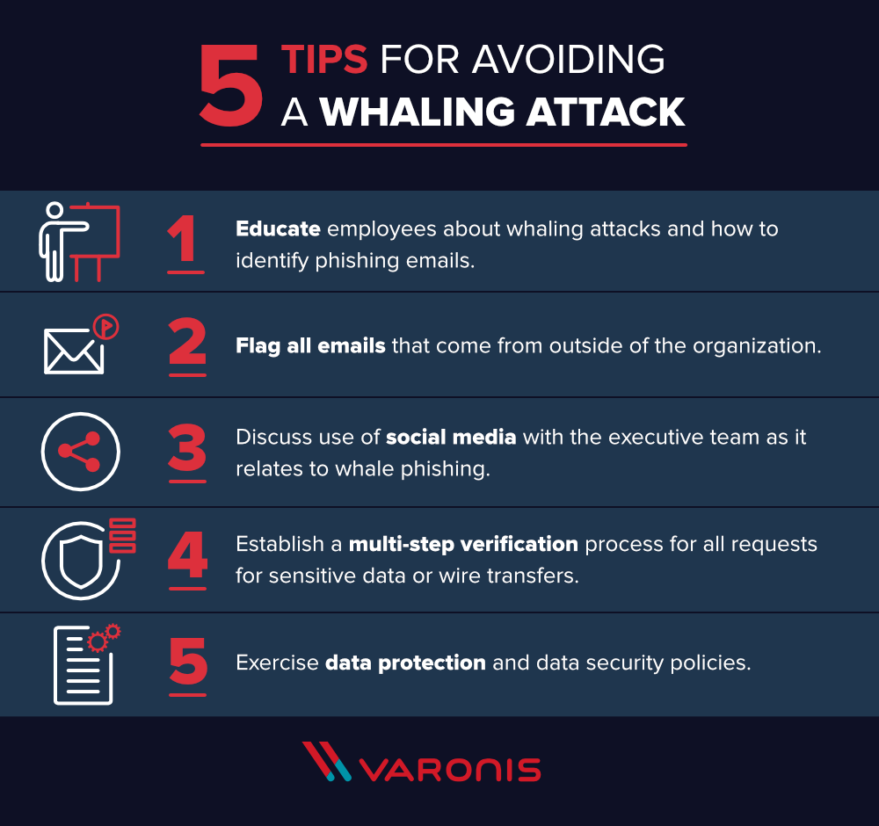

Slide 9


Now it's time for hands on!
Using Kali Linux (released in 2013)
Kali is used by pen-testers.

Slide 10



Tools Used...
1. EtterCap
2. WireShark

Slide 11
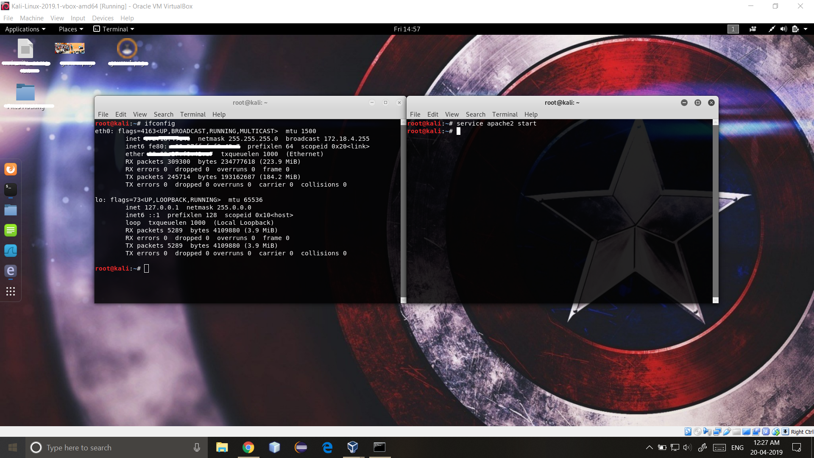

Slide 12
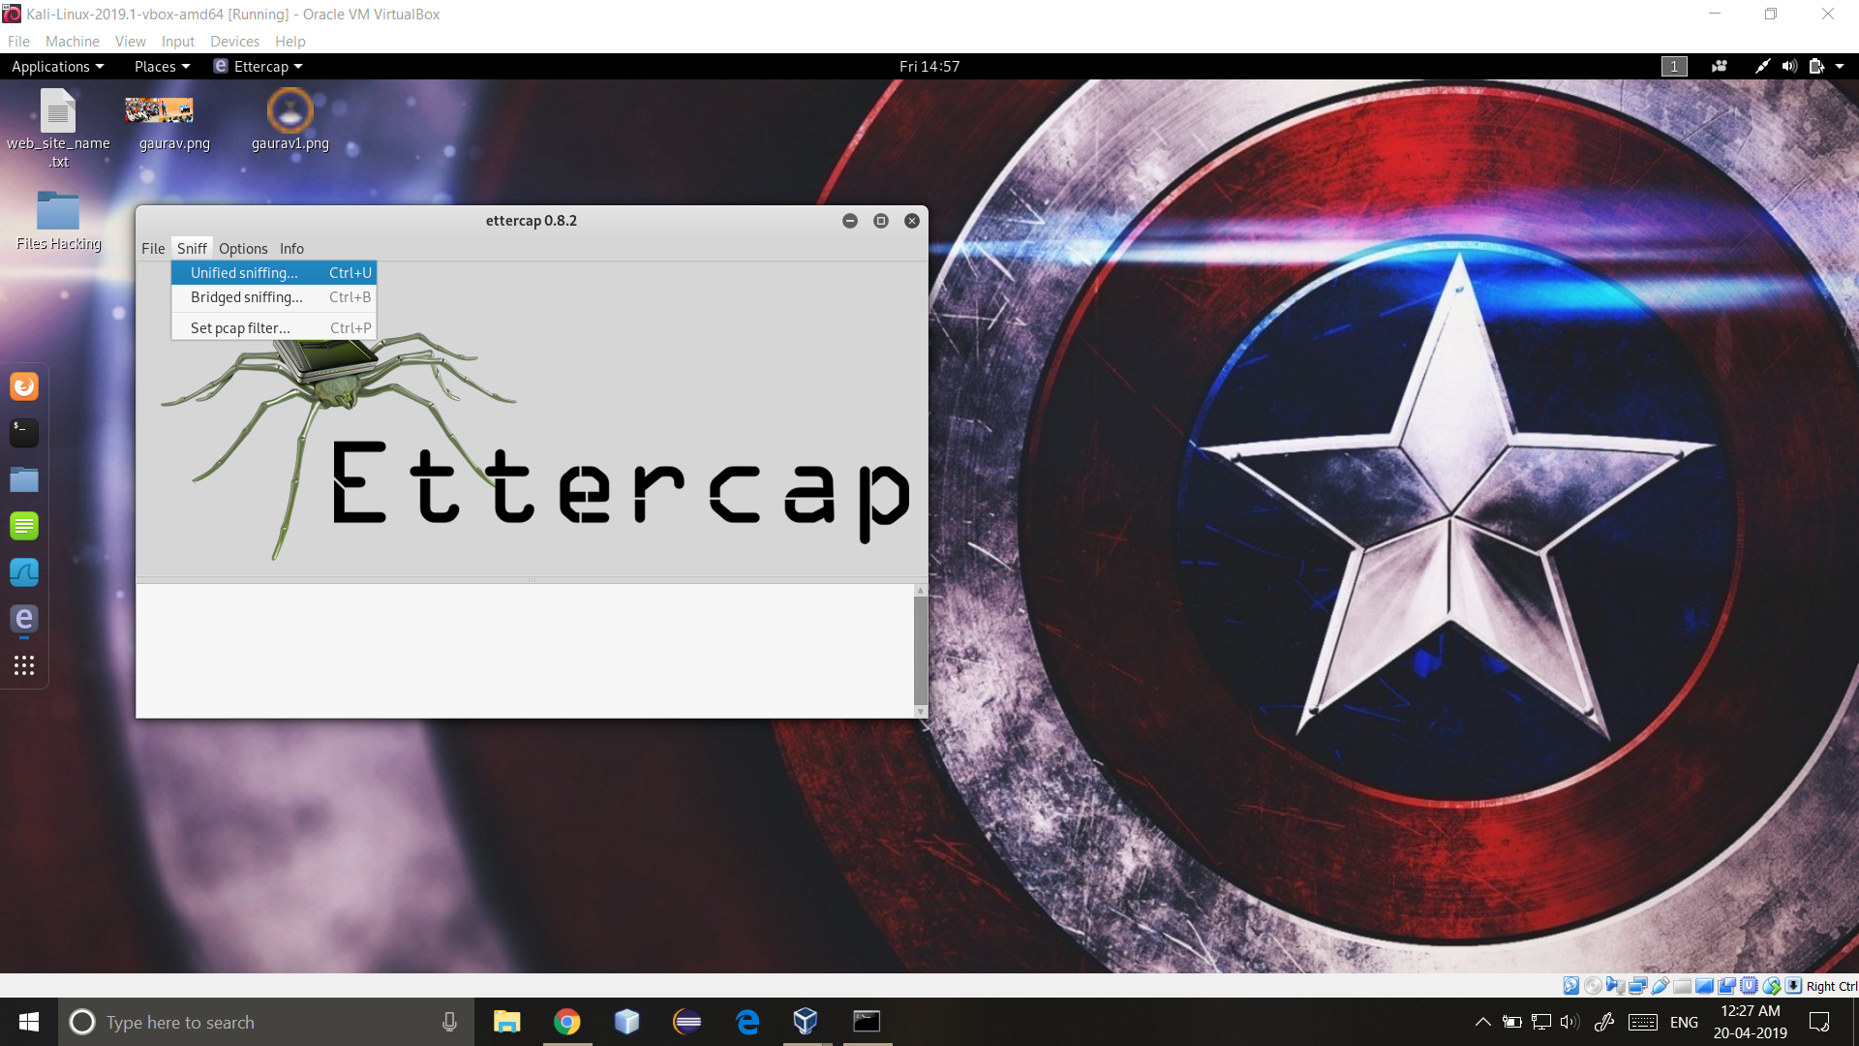

Slide 13
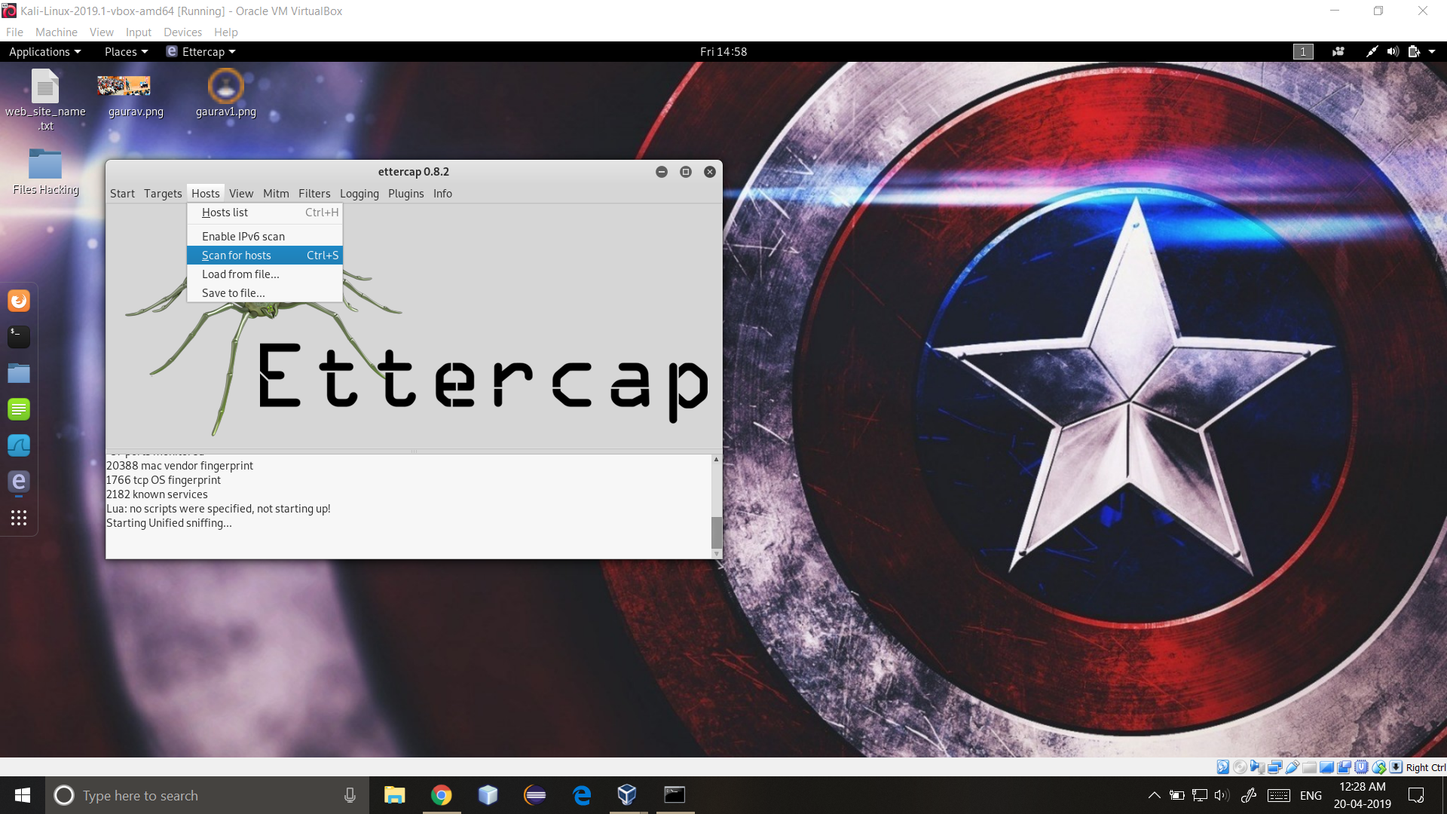

Slide 14
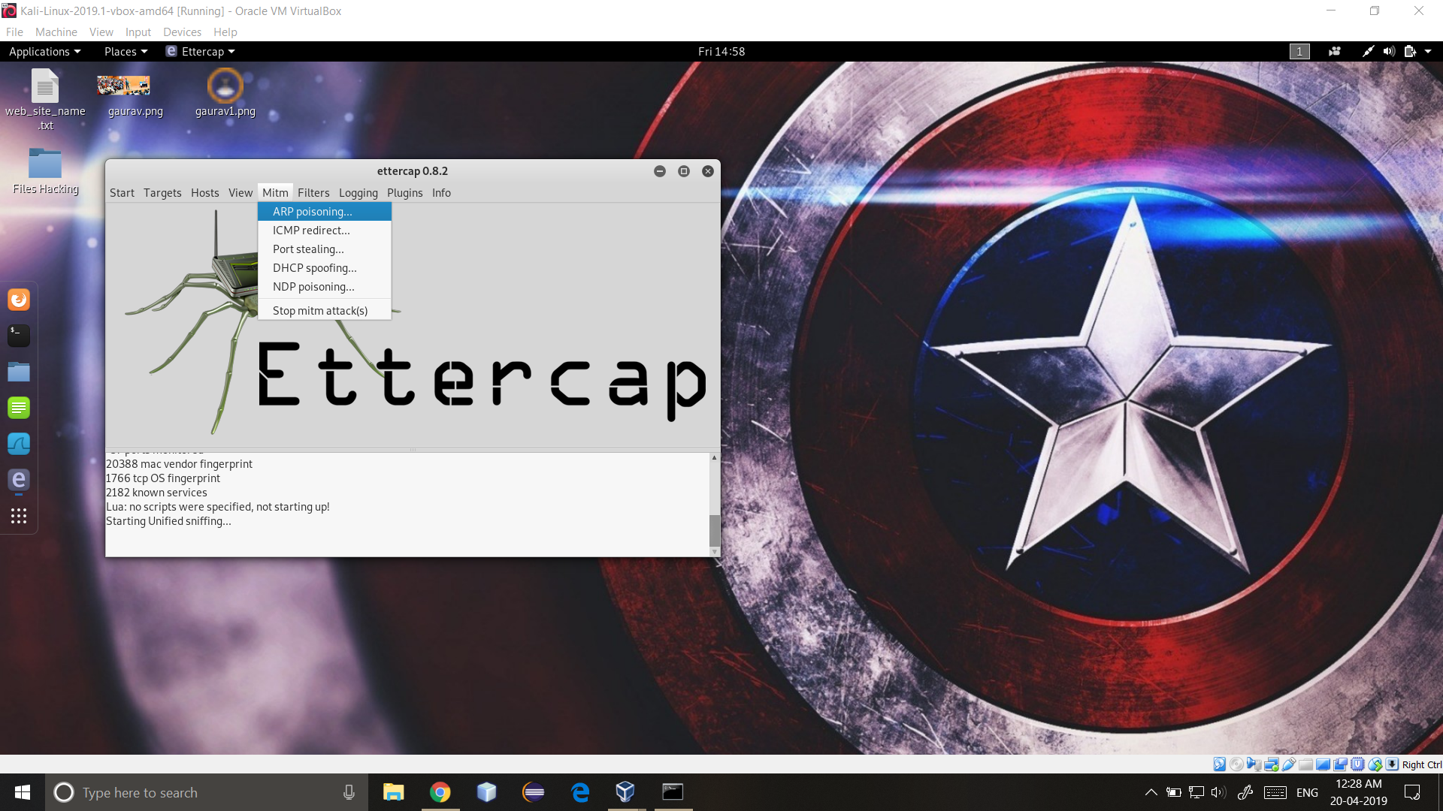

Slide 15
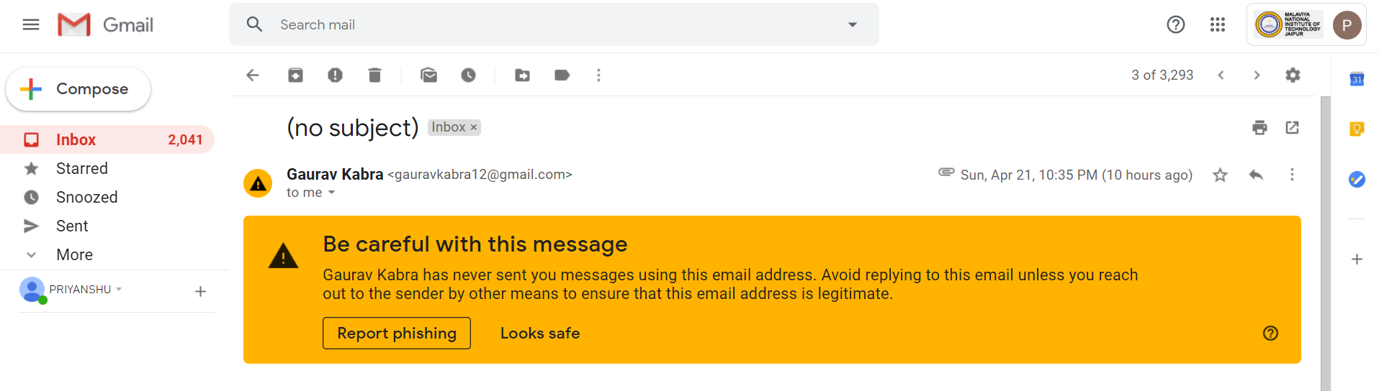

Slide 16


